Slide 1


Full-stack Development
Part-3
i4java

Slide 2
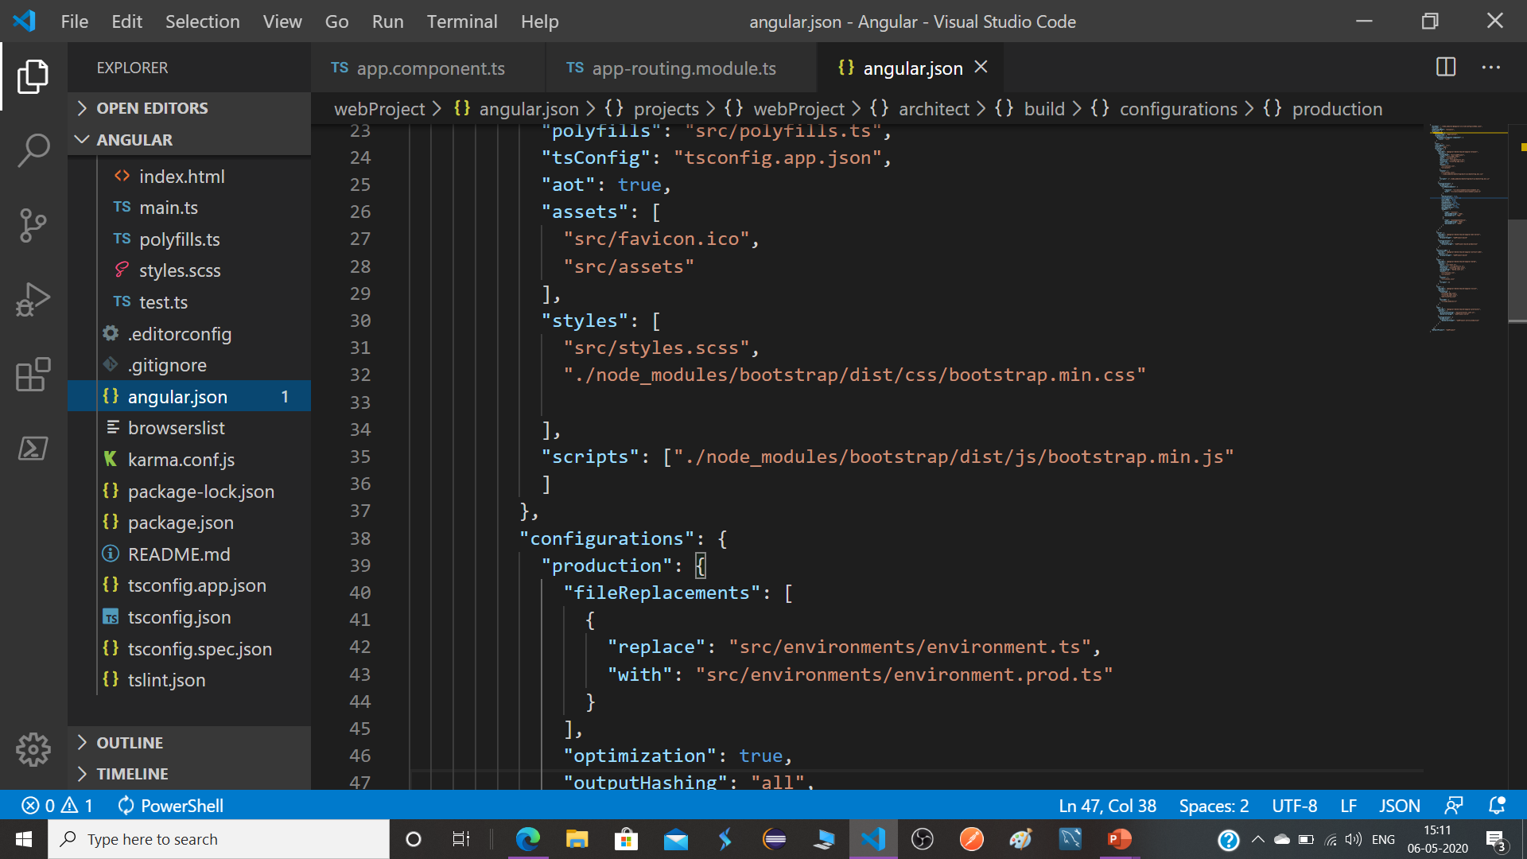
i4java

Slide 3
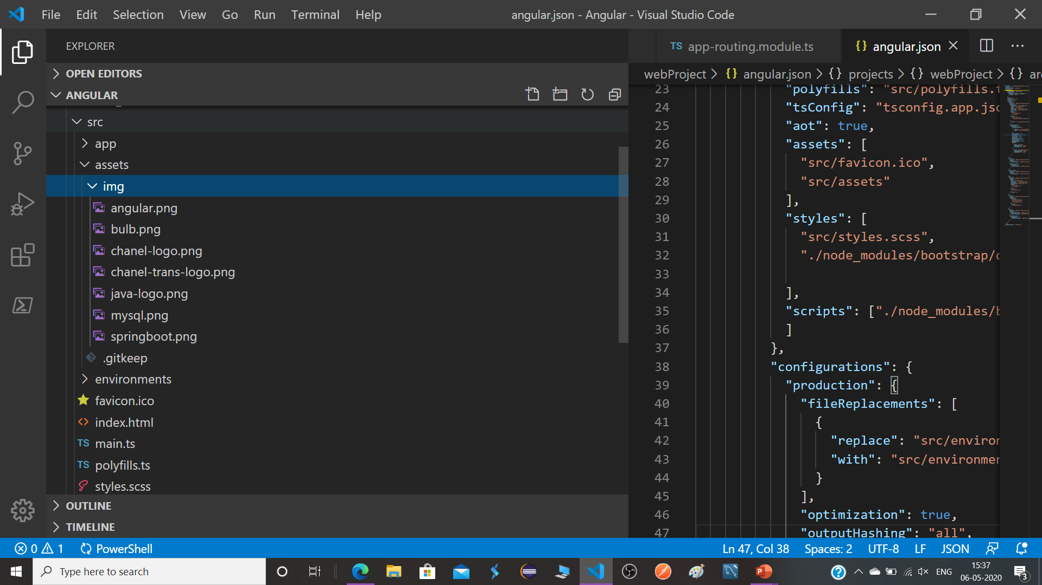
i4java

Slide 4
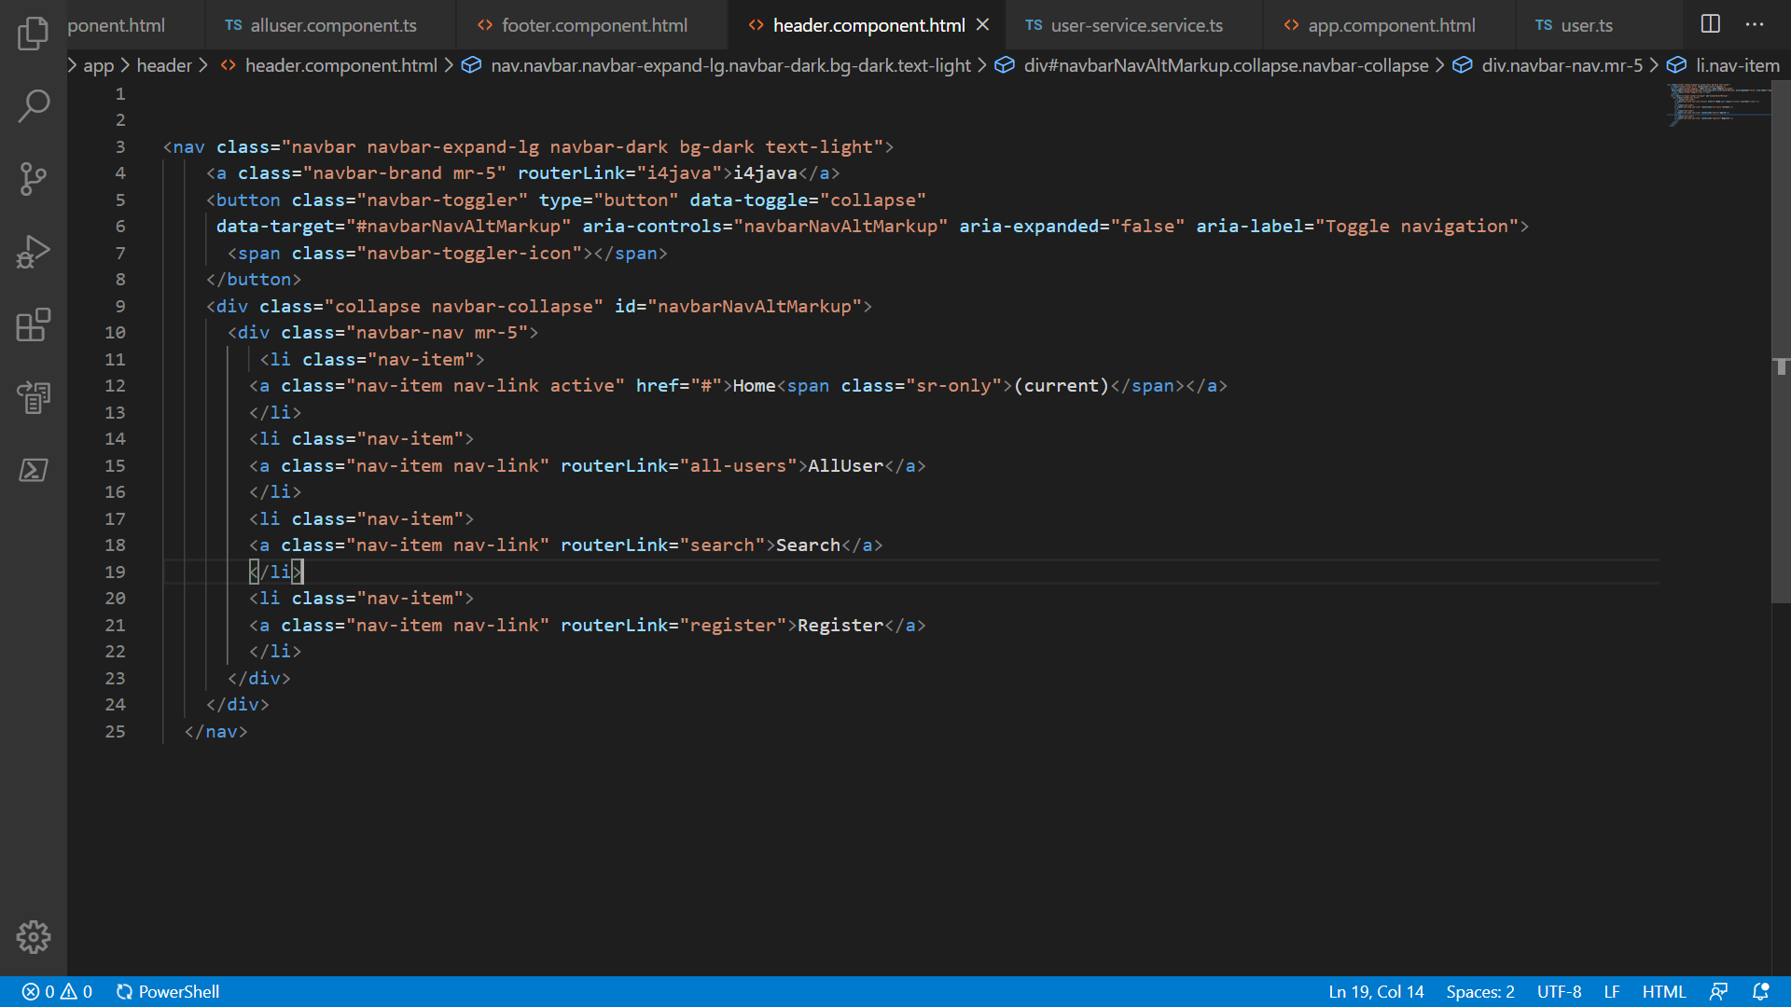
i4java

Slide 5
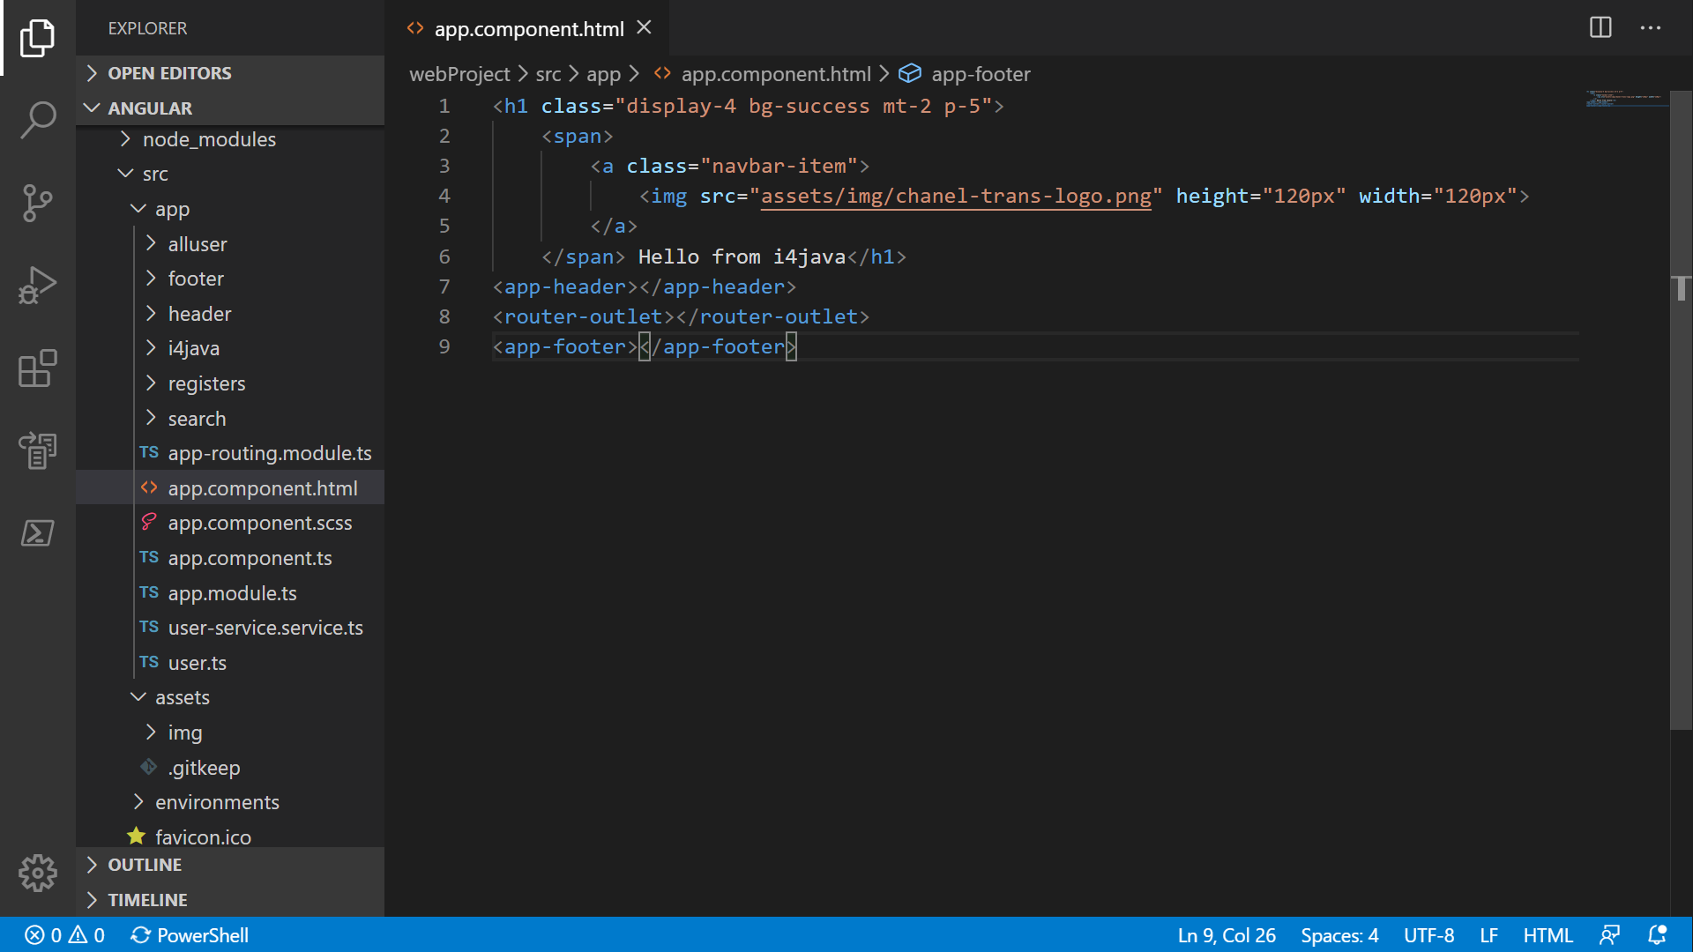
2 steps
Create all six components 1st
i4java

Slide 6
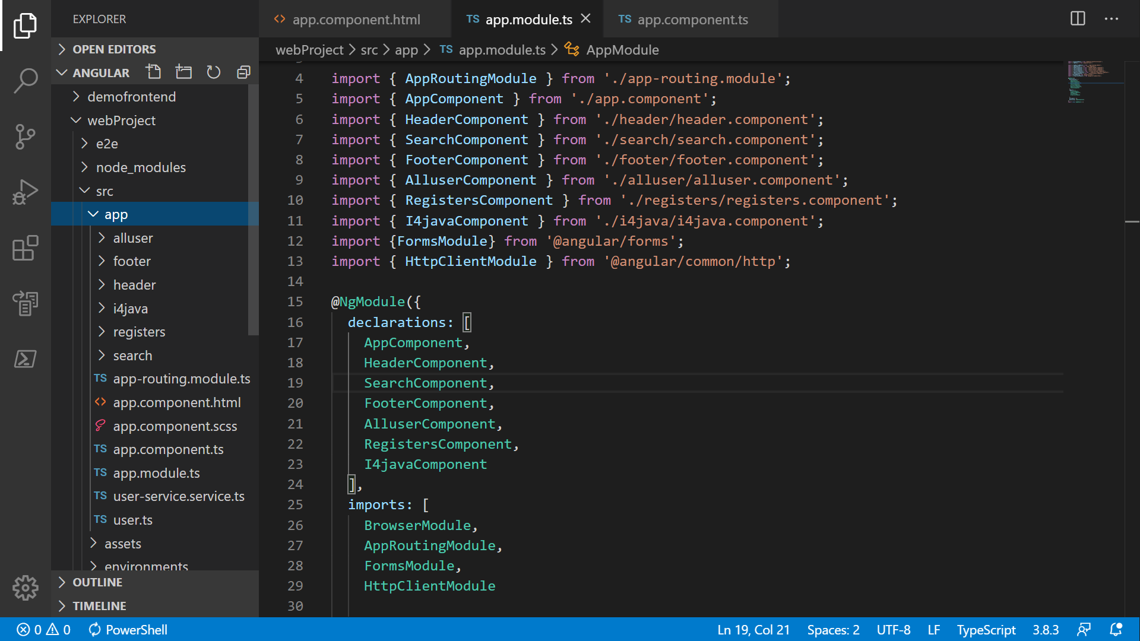
i4java

Slide 7
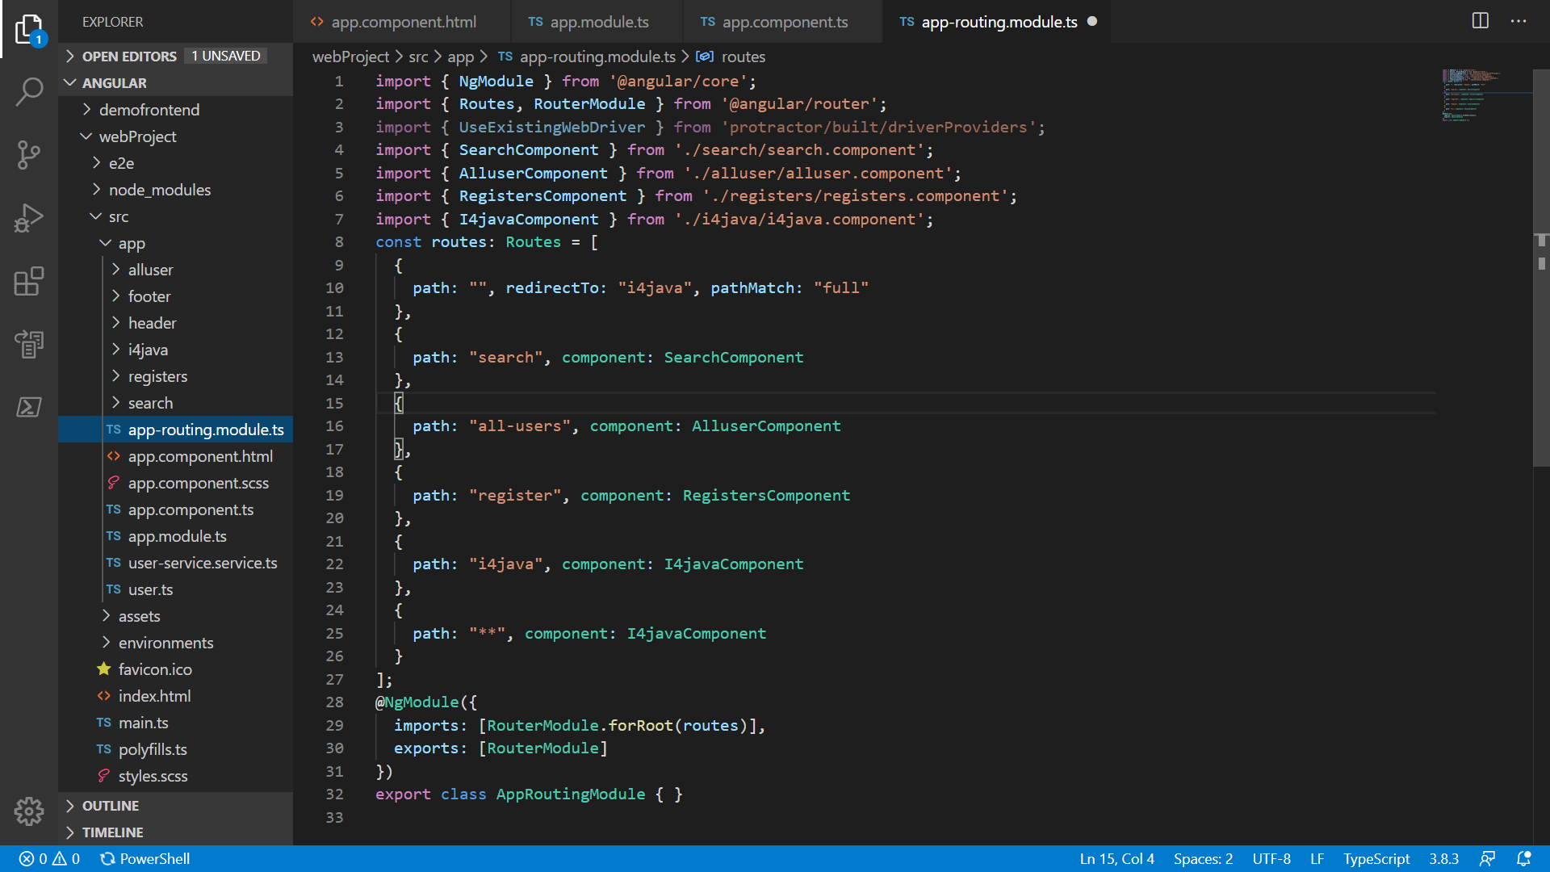
For routing create routes path 1st.
i4java

Slide 8
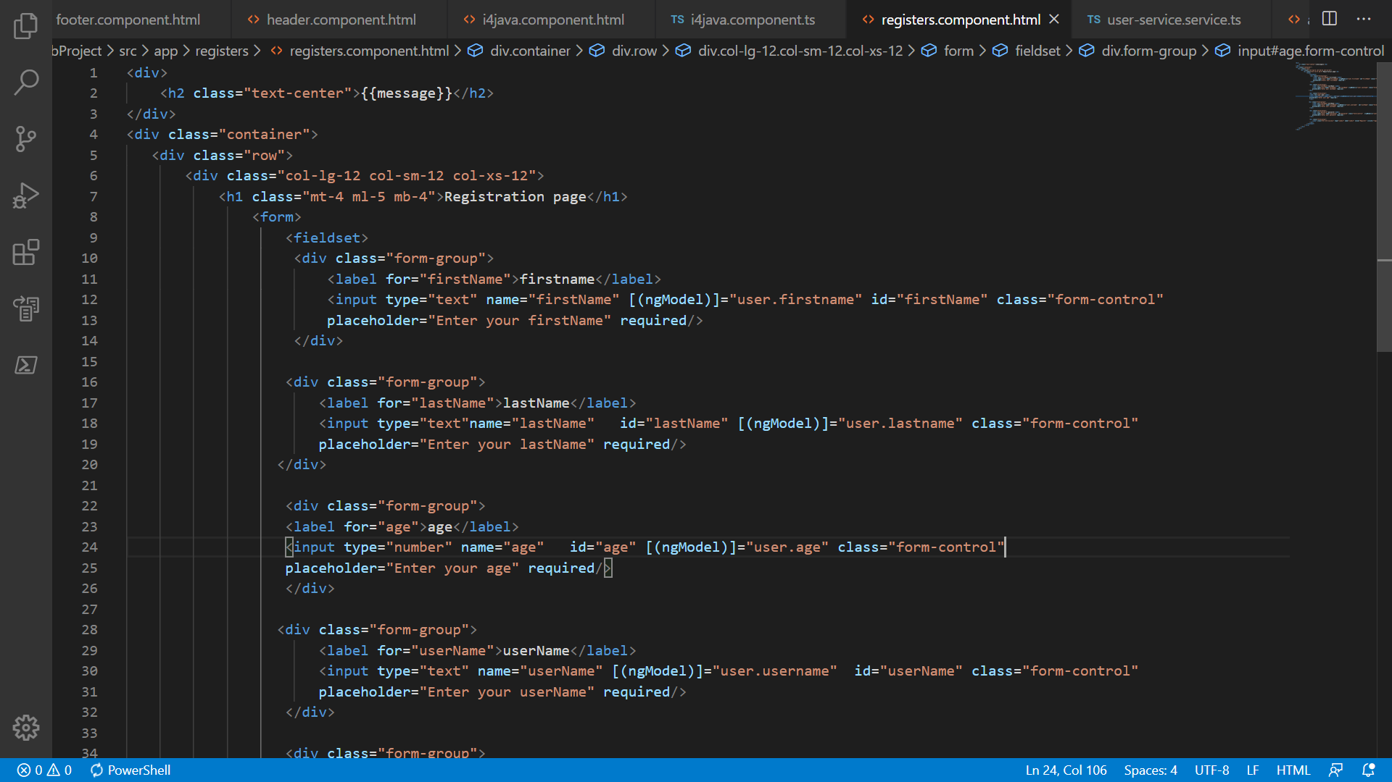
Part-1
i4java

Slide 9
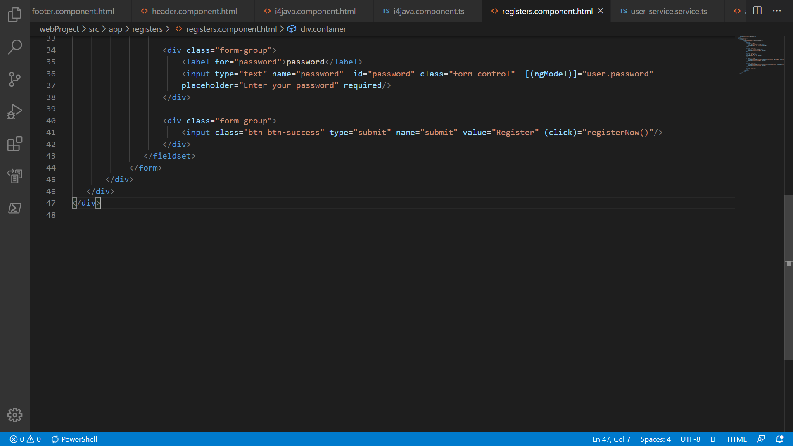
Part-1 continuation
i4java

Slide 10
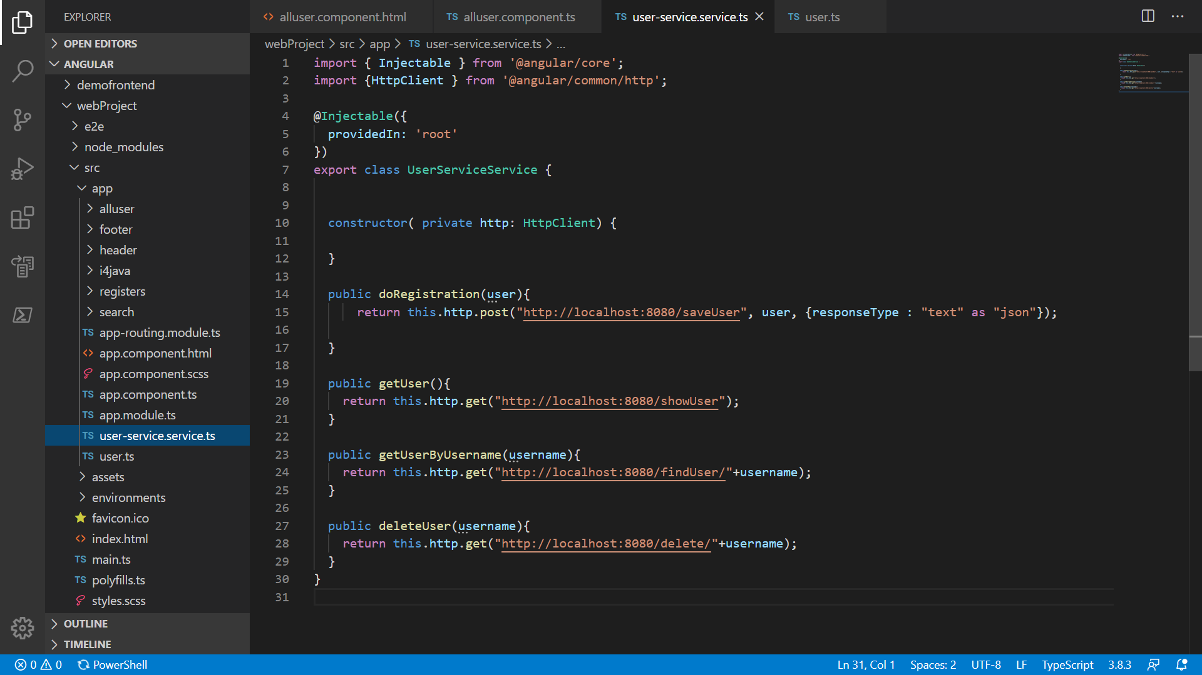
1
i4java

Slide 11
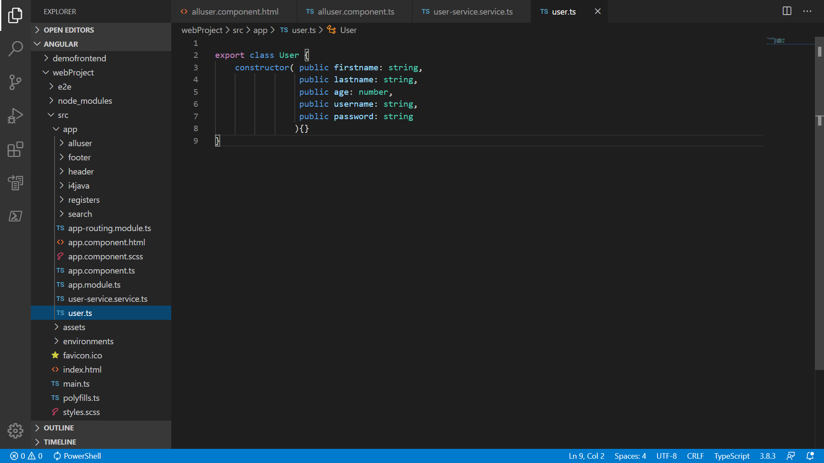
Create one typescript class
i4java

Slide 12
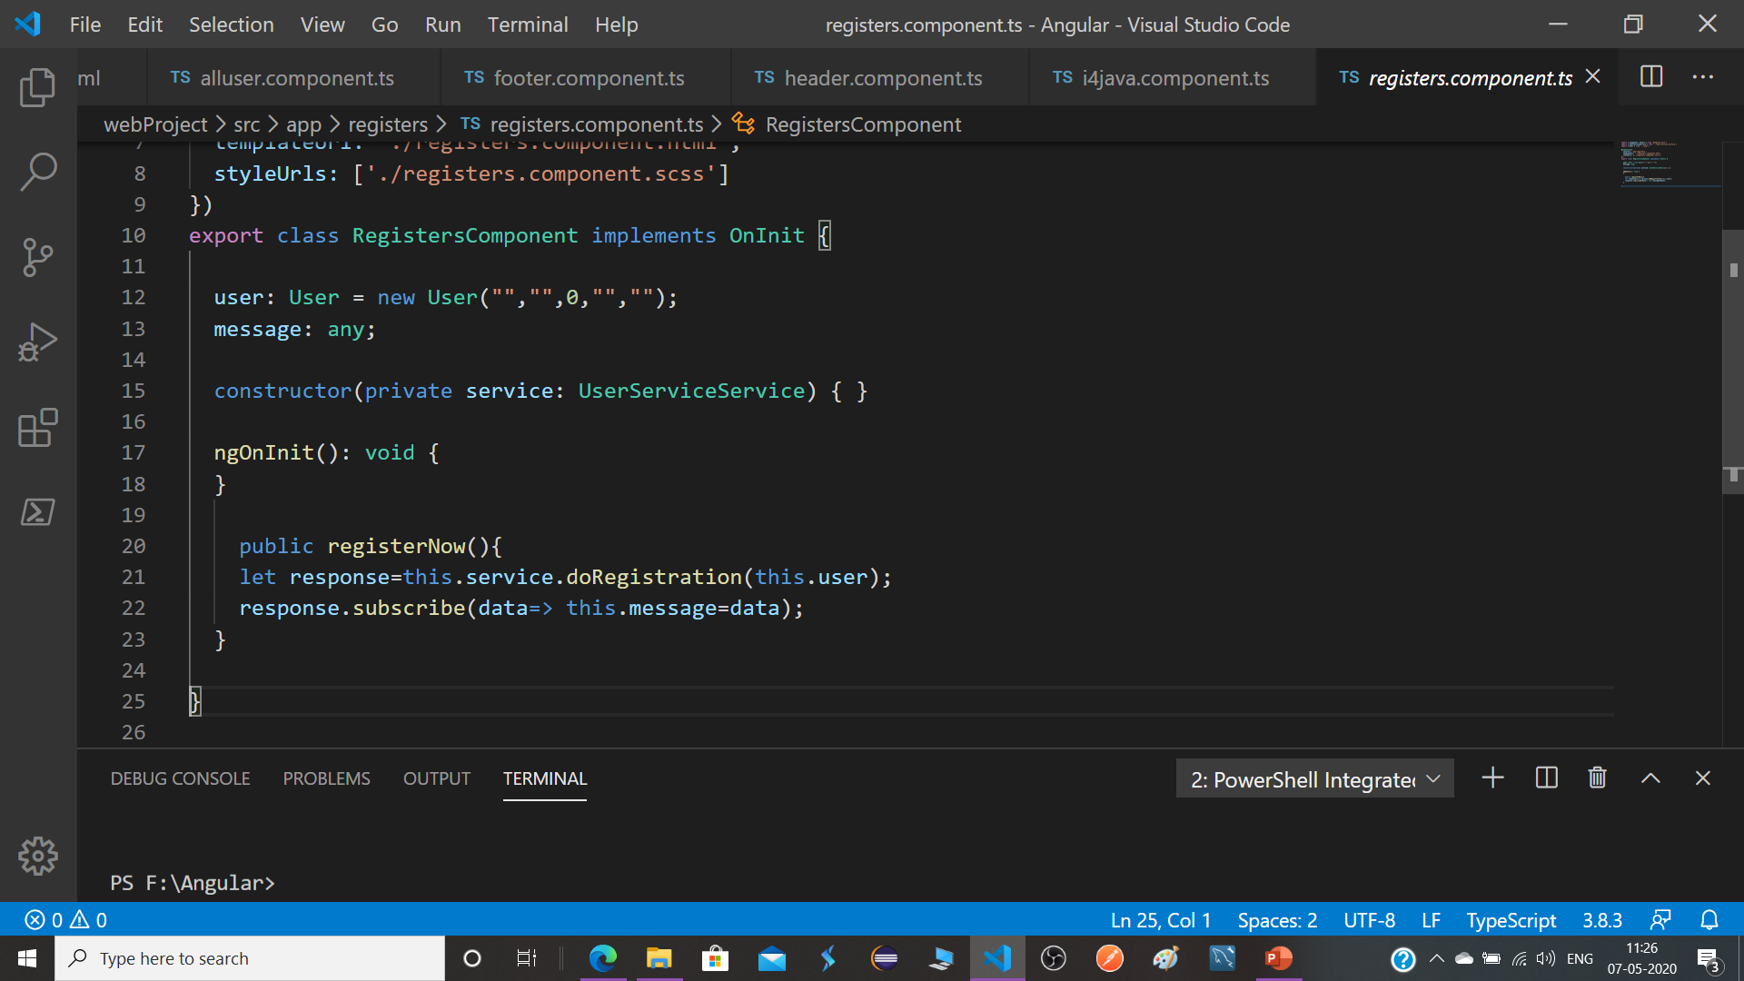

Slide 13
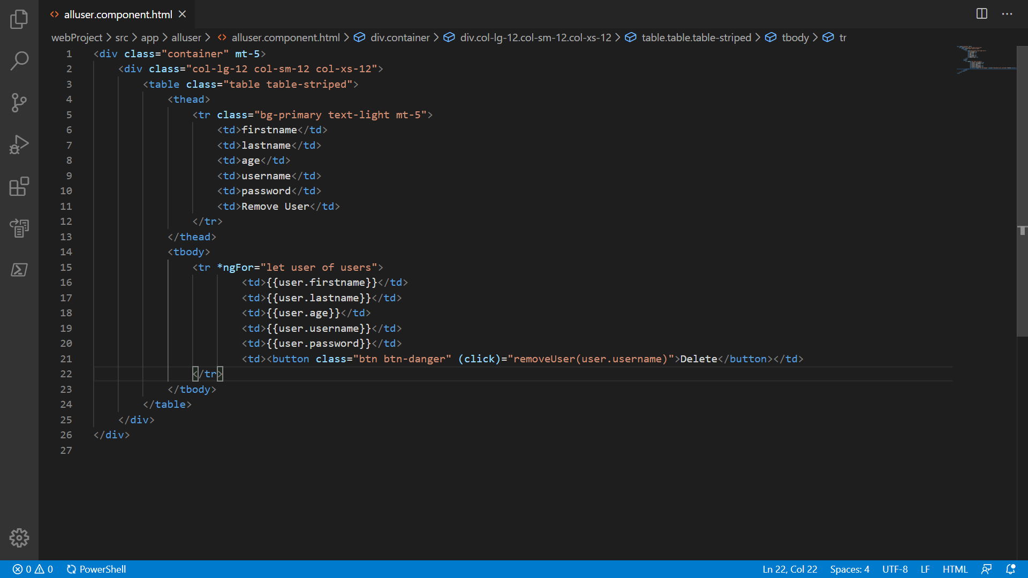
i4java

Slide 14
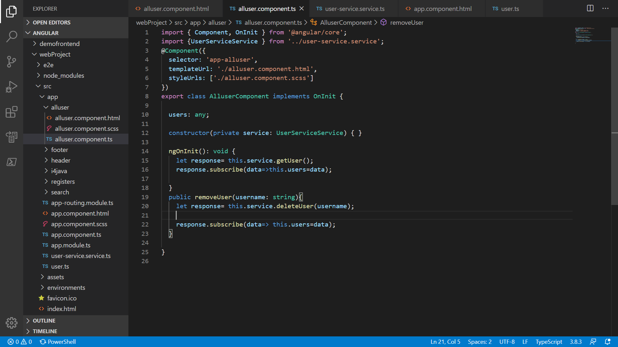
i4java

Slide 15
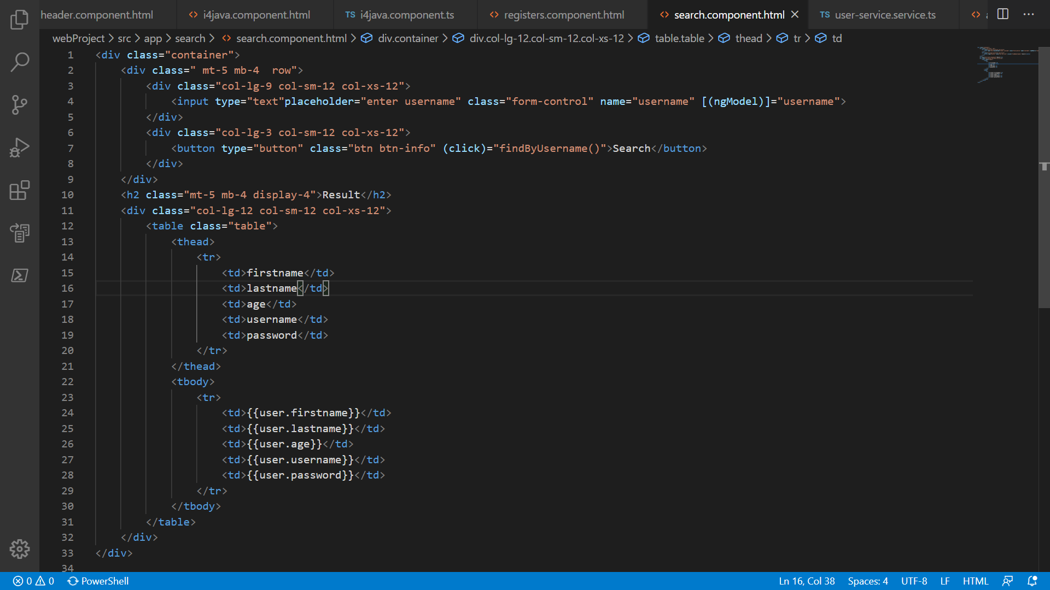
i4java

Slide 16
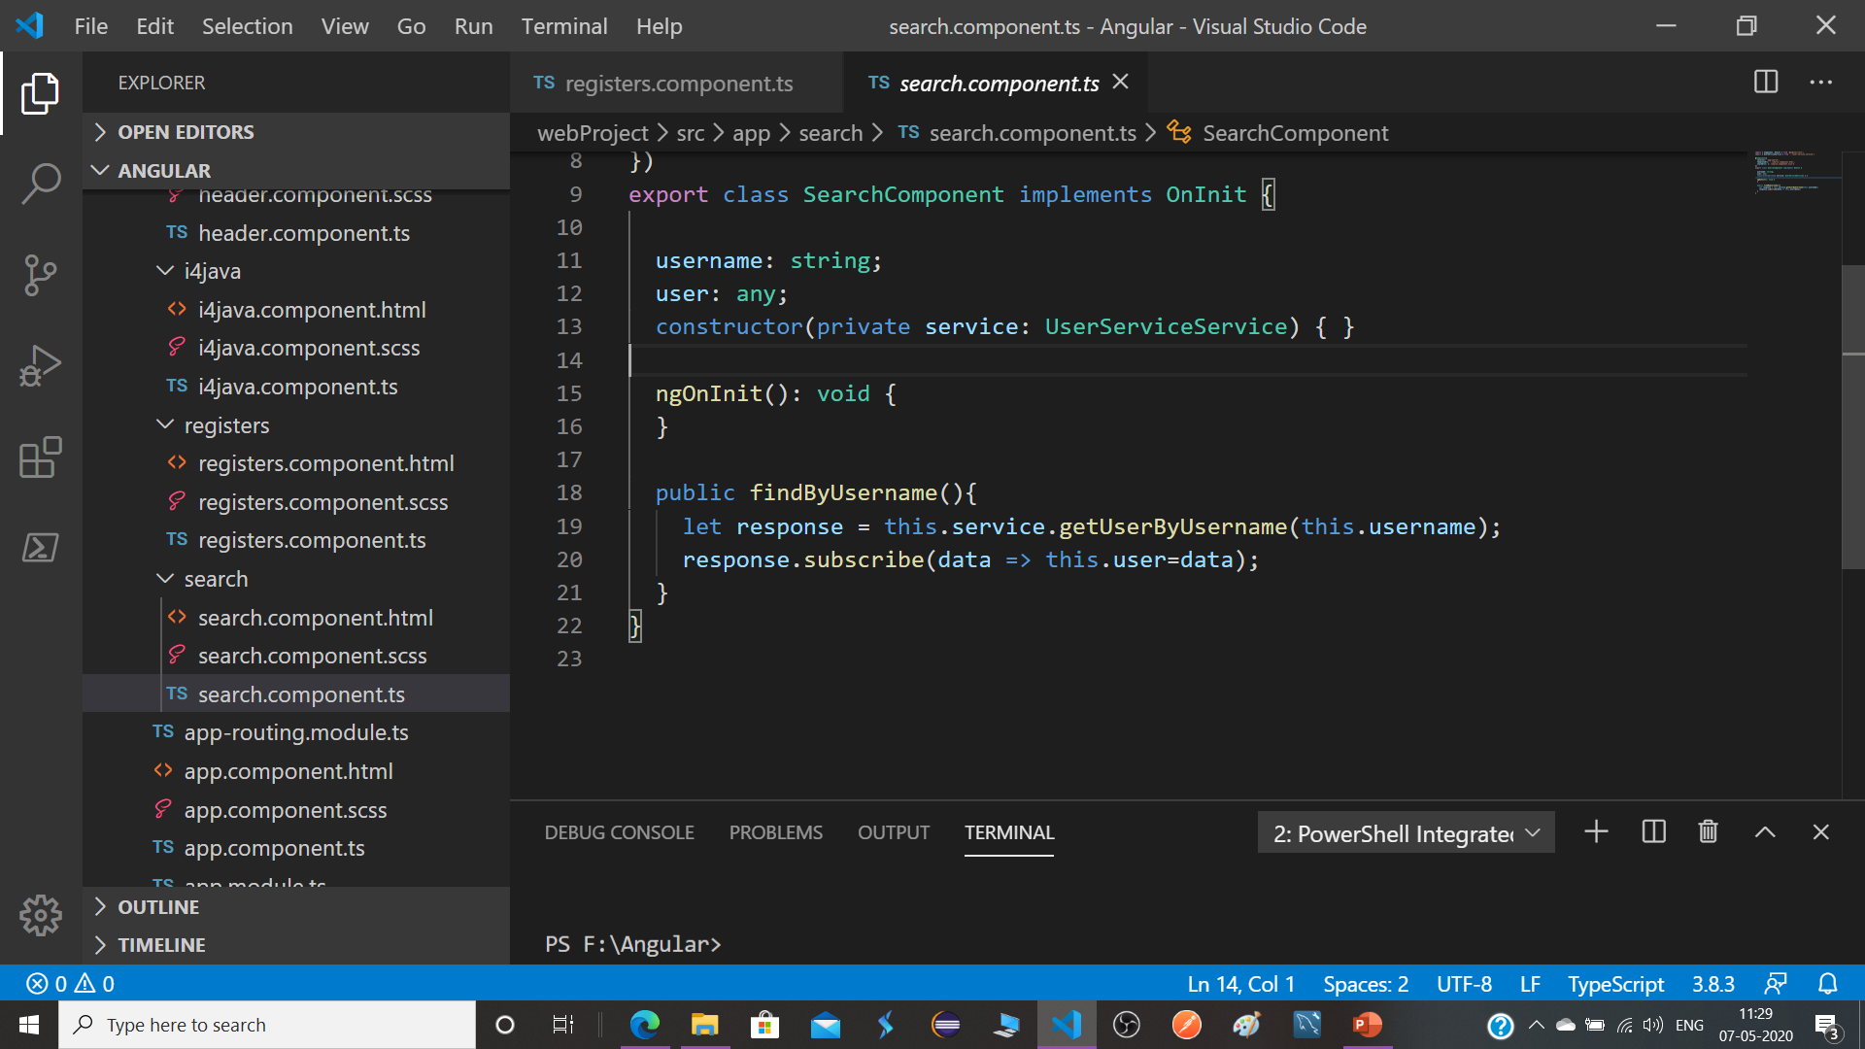

Slide 17
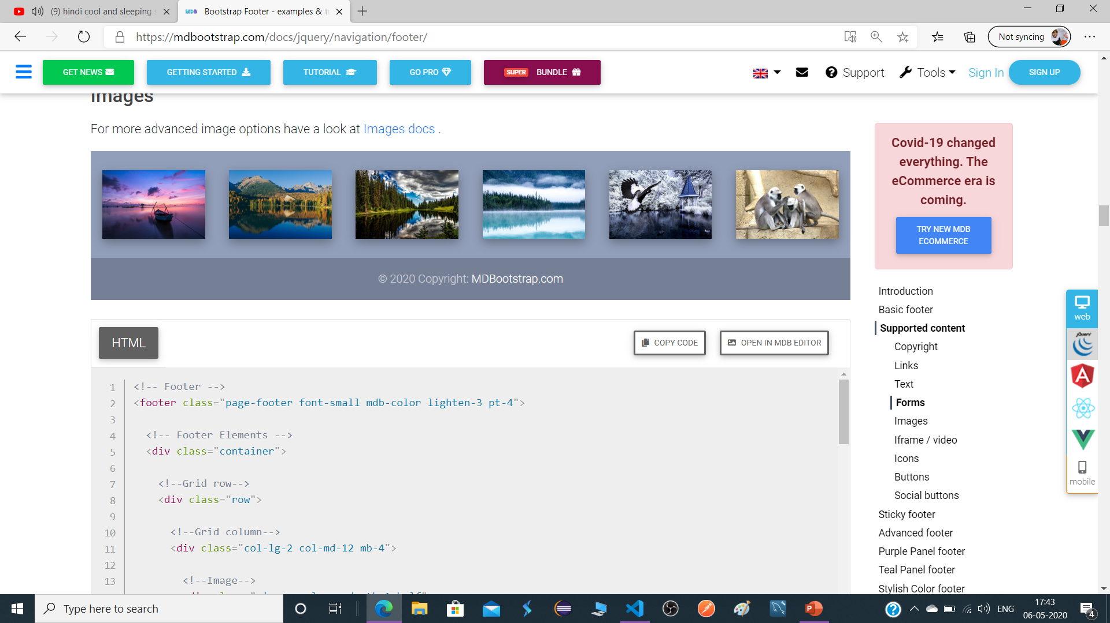
https://mdbootstrap.com/docs/jquery/navigation/footer/
i4java

Slide 18
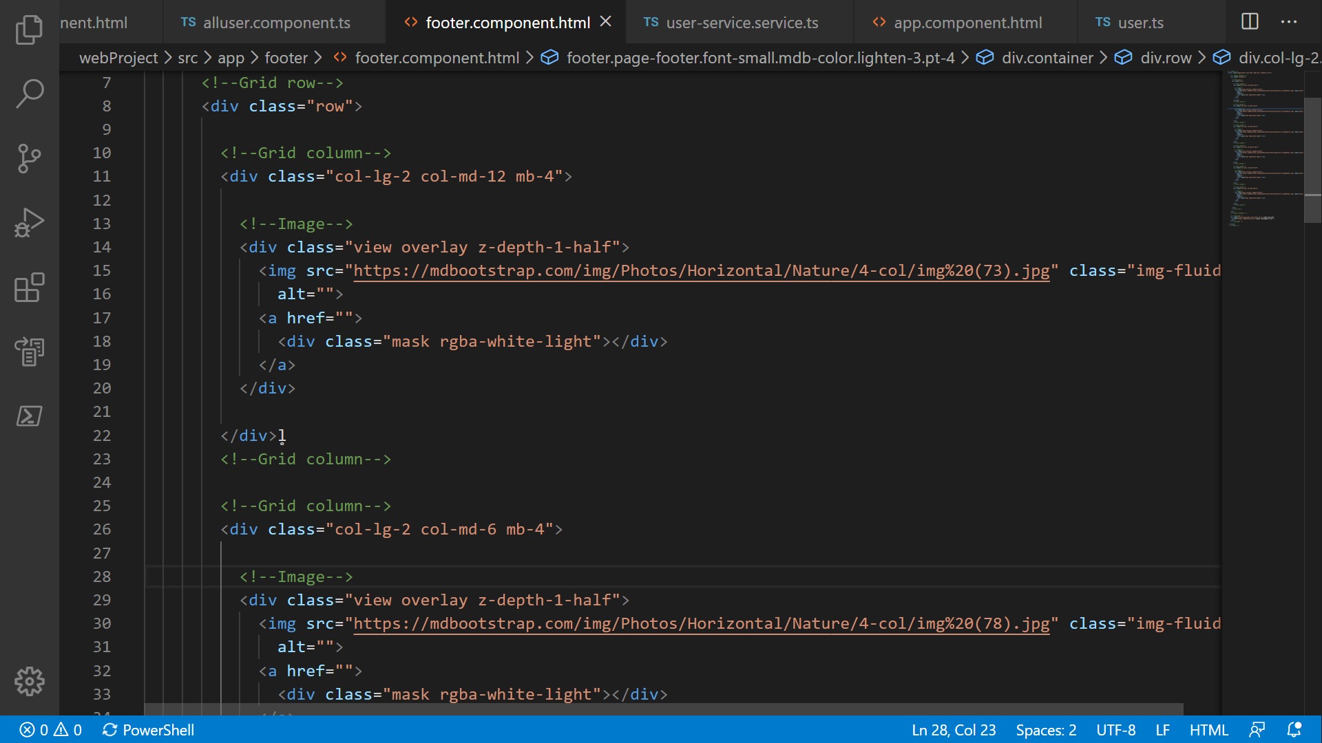
Paste here code and you all done
i4java

Slide 19
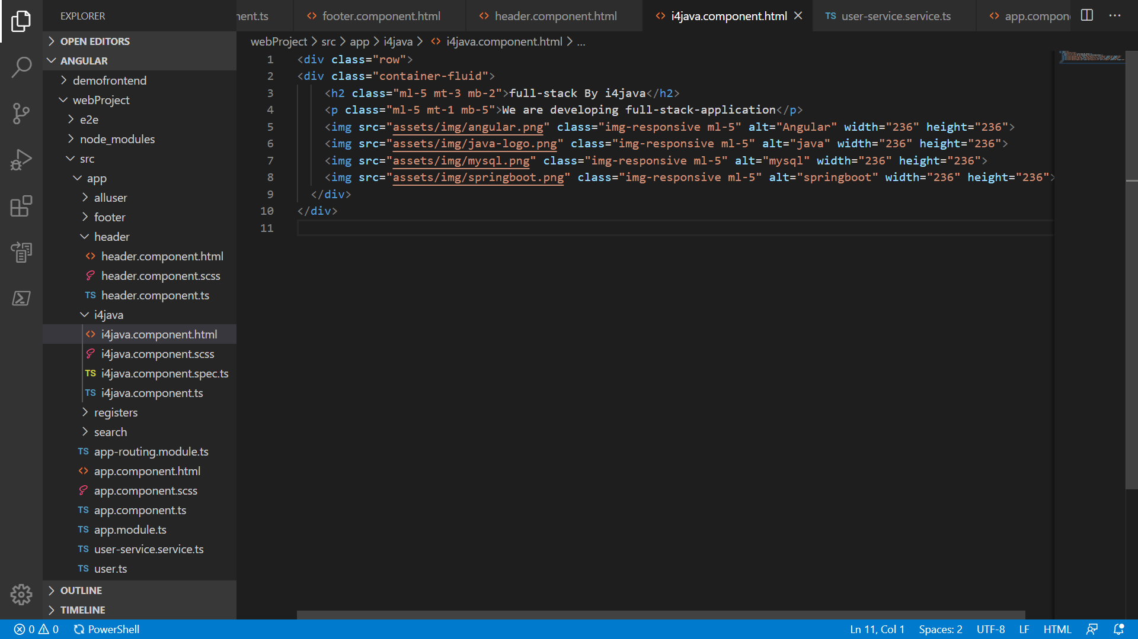
i4java

Slide 20
Thank you
For
Showing your Interest
i4java
Subscribe

